Slide 1
Audience
Venture capitalists who are interested in the music entertainment business.
Background
Currently there is a strong demand for karaoke in the U-District. There is a building under construction on 12th and 45th that we plan on leasing for our business.

Slide 2
Armada

Slide 3
Our Team
Chief Executive Officer……..Vincent Lau
Chief Marketing Officer…….Jessica Sugianto
Creative Director………………..Sophia Chia
Advertising Manager………..Chris Zuydhoek
Chief Financial Officer………Matthew Li

Slide 4
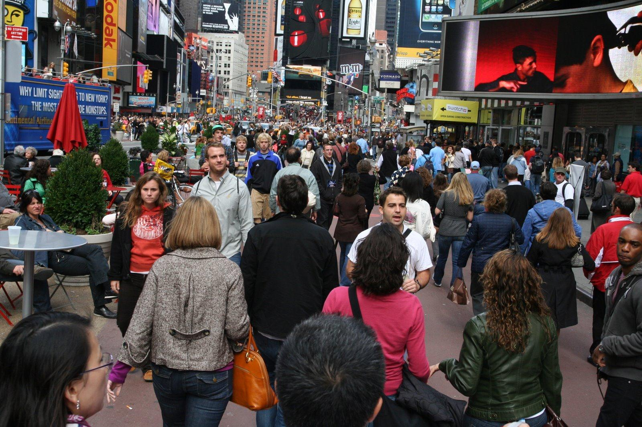

Slide 5
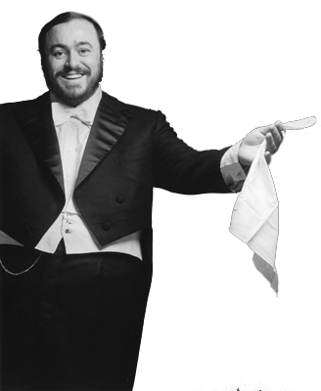

Slide 8
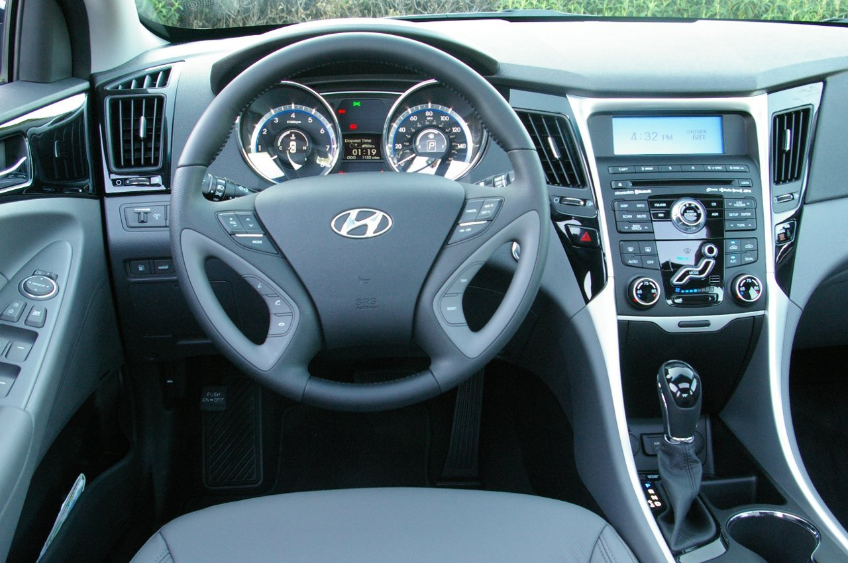

Slide 10
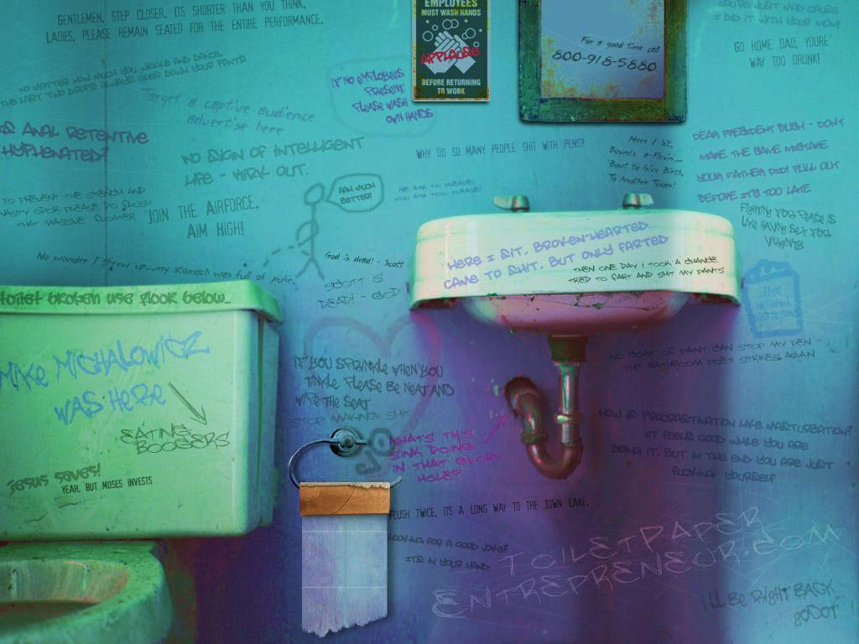

Slide 11
Lovin’ You
Is easy cause, you’re beautiful.
Making…

Slide 12
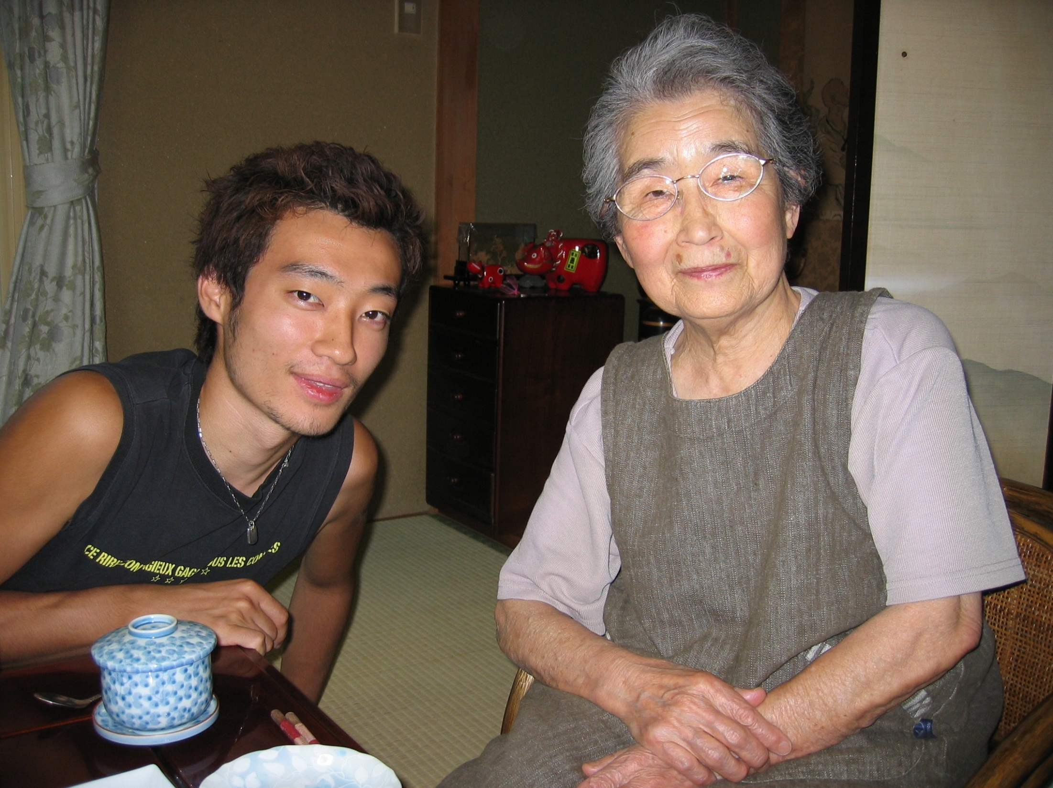

Slide 14
Armada
KARAOKE
Seattle

Slide 16
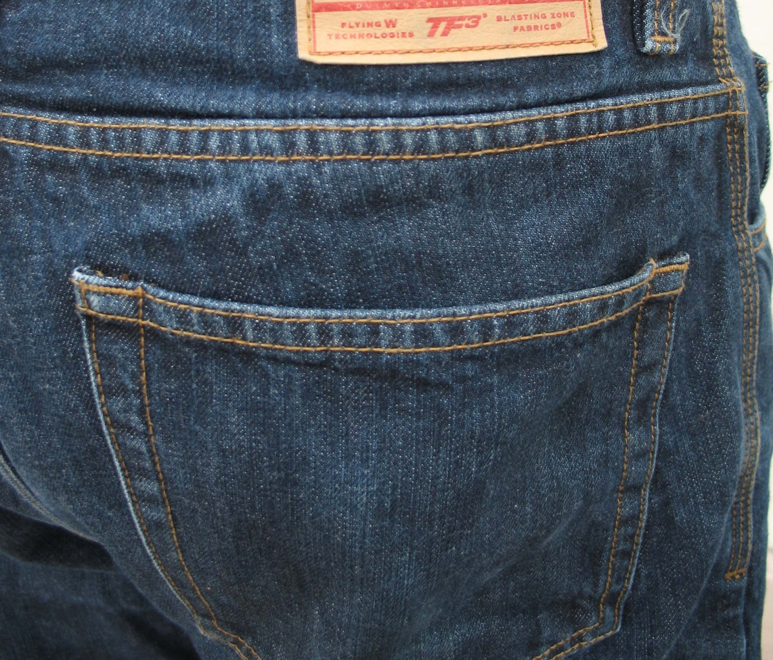

Slide 17
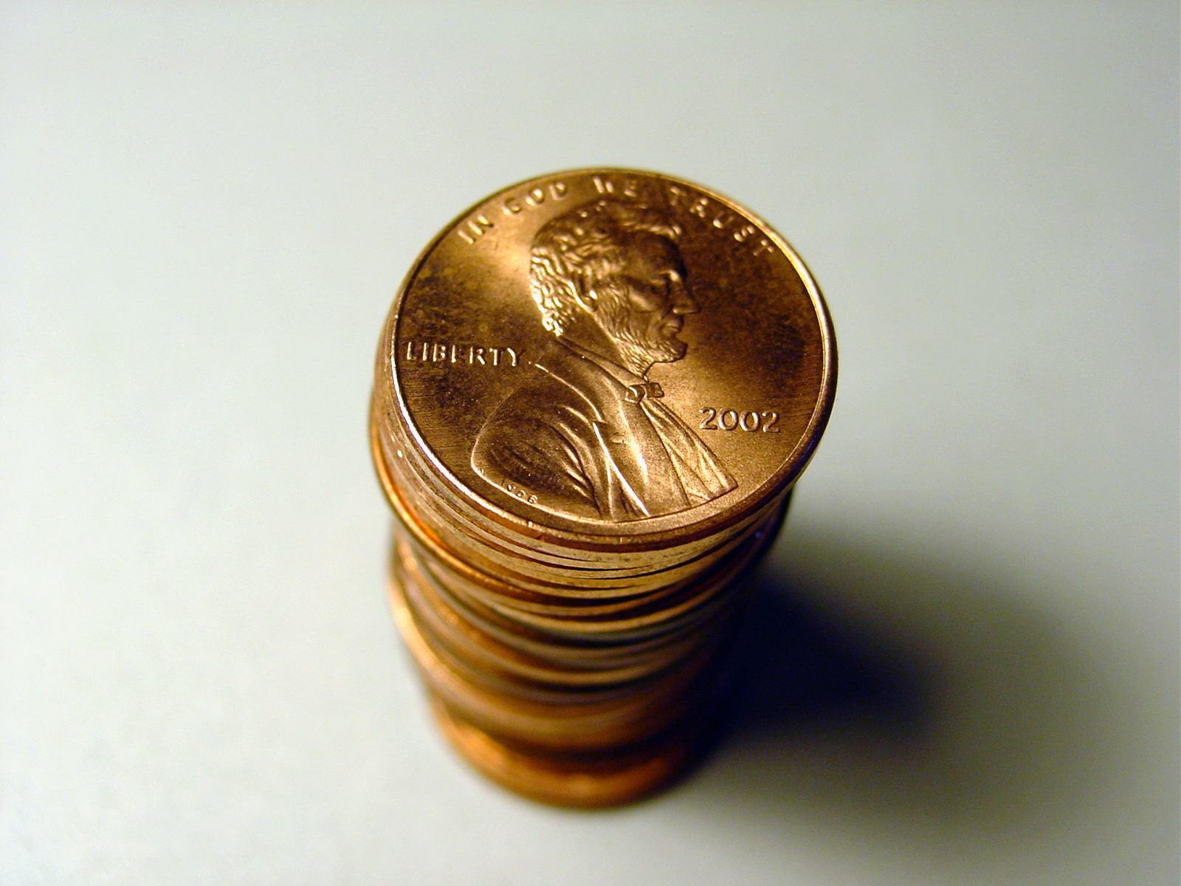

Slide 18
DEMAND

Slide 19
# of Karaoke Boxes

Slide 21
Operations
Positioning
Financing
Promotion
Closing

Slide 23
S e a t t l e

Slide 29
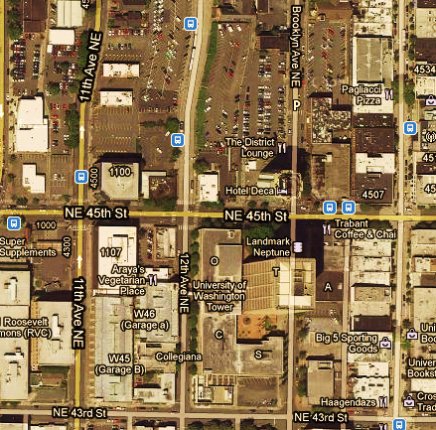
L O C A T I O N

Slide 30
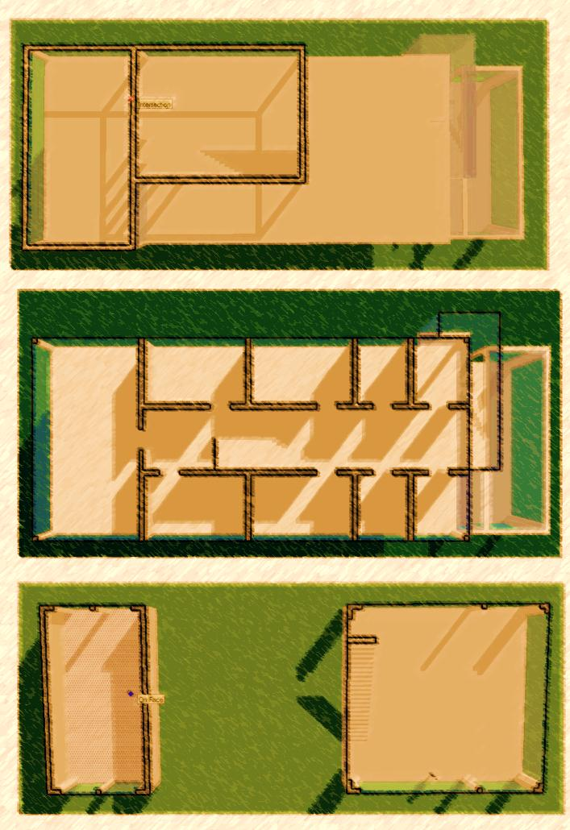
F
LOOR
3
2
PLAN
1

Slide 32
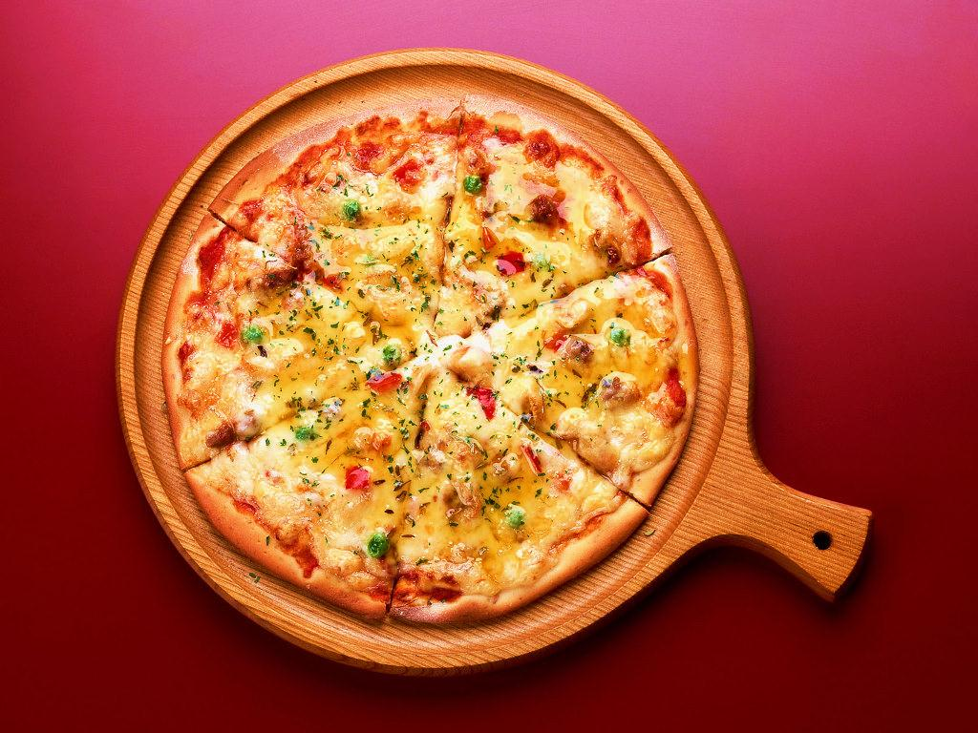
FOOD AND DRINKS

Slide 33
RATES & HOURS
 | MONDAY-THURSDAY | FRIDAY | SATURDAY -SUNDAY
HOURS | 4pm-4am | 3pm-4am | 11am-4am
SMALL | $20 | $25 | $25
MEDIUM | $30 | $35 | $35
LARGE | $40 | $45 | $45

Slide 35
Operations
Positioning
Financing
Promotion
Closing
Notes:
I am a big karaoke fan.
When I first came to Seattle, I was really looking forward to some hardcore karaoke jamming sessions in a
“modern and nicely designed venue.”
Overall, the experiences I had on U district were satisfying, but I was not as blown away as I was by other places.
*I definitely saw room for expansion and improvement, especially with the design.
This is why I am super excited to be the creative director for this project mainly focusing on the interior design part.
You may be wondering; truly, how important is the interior design in terms of generating profit?
Well, in the karaoke entertainment business, companies have two main marketing objectives.

Slide 36
1.
Satisfy the need
Notes:
The first is to simply give the customers what they need.
As a wise man once said, put out the fire! If the fire is the demand for karaoke space and song systems, provide that.

Slide 37
O
The
WOW factor
2.
Notes:
However, to delight customers and create long-lasting customer relationships, companies must have a wow factor to distinguish themselves from their competitors.
And our wow factor just happens to be (click) our very cool and awesome….

Slide 38
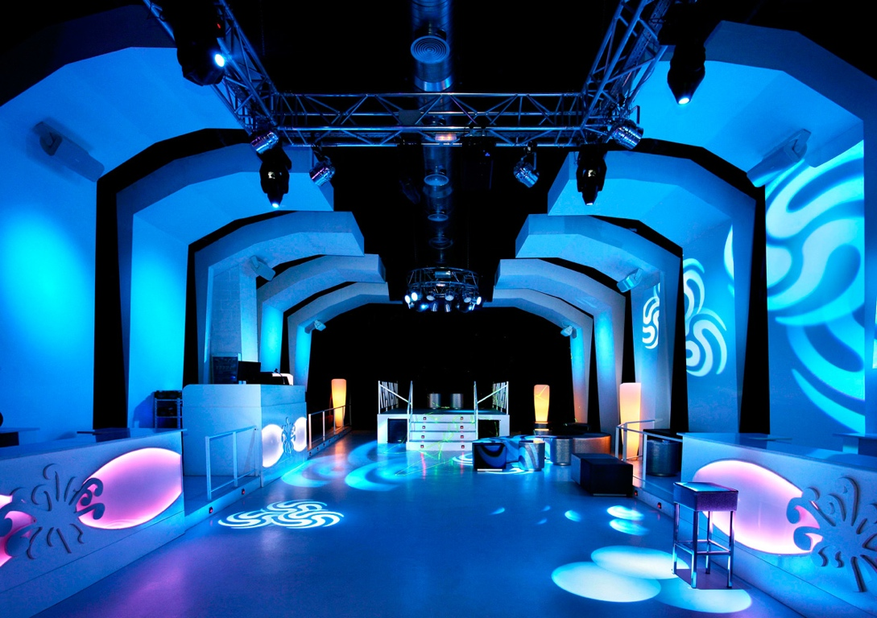
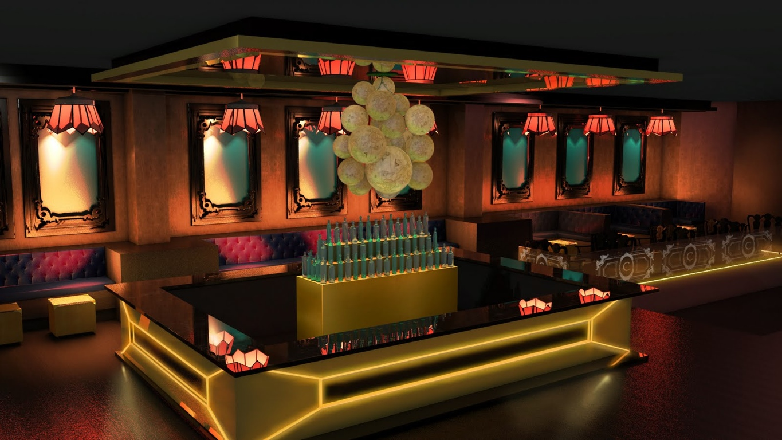
Interior
WOW
Design
Notes:
….Interior design!!
The Interior design is an essential part of our store personality and positioning and it is what creates an impressionable experience for our customers. It is really the soul of our business
Now, in every stage of the designing process, there is one core idea that we always keep in mind, our target market.
As Jessica said, our target markets can be divided into the customers who already enjoy karaoke and those who are new to it.

Slide 39
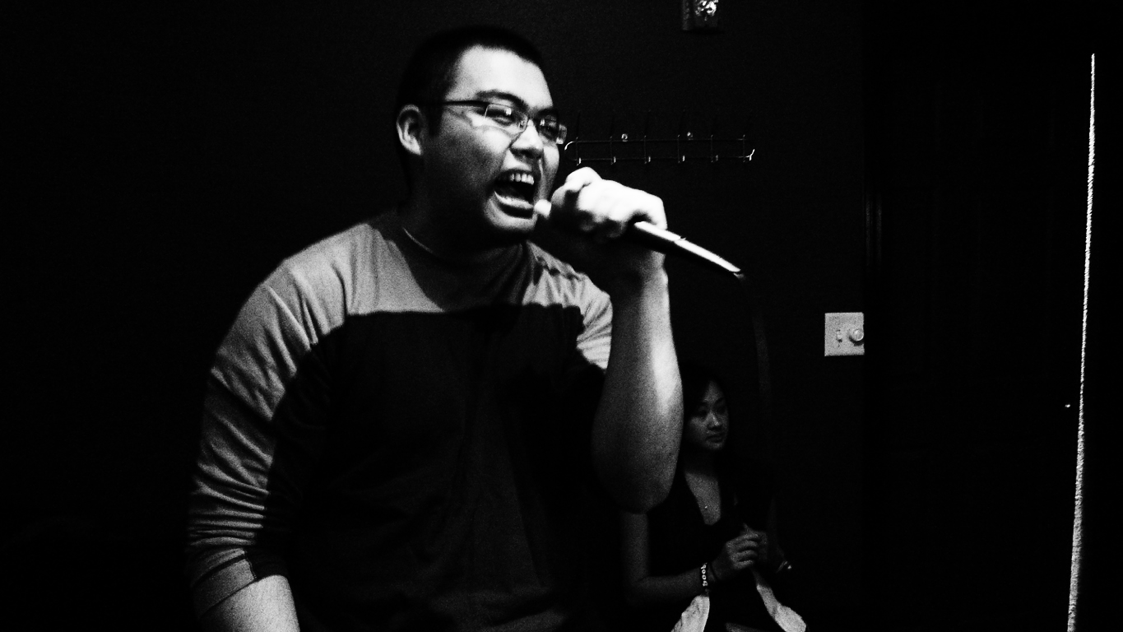
#1
Target Market
Notes:
The first group generally have the following characteristics:
They are mainly interested in pop music,
are socially active,
and enjoy singing and expressing themselves in front of their friends.
Many of the people from this group are in fact Asian international students, since karaoke is a main part of their culture.

Slide 40
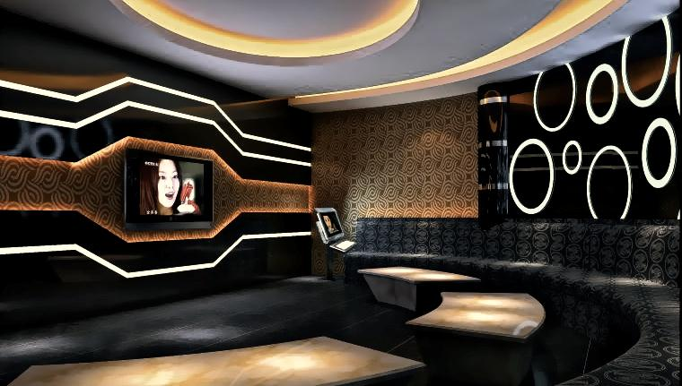
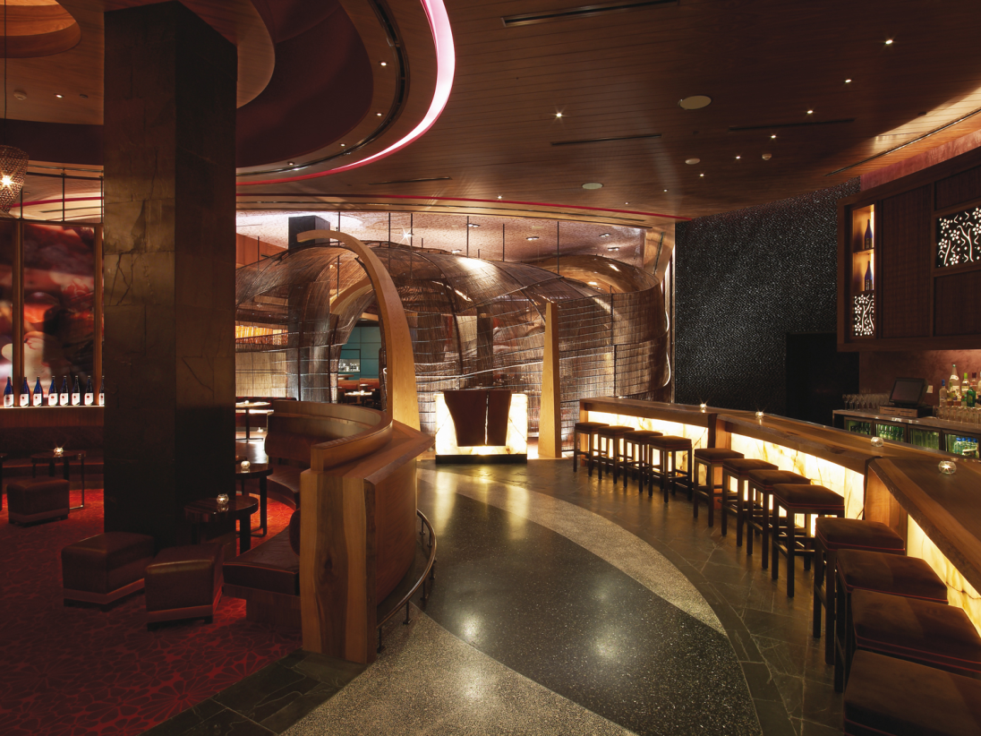
K
araoke
Meets
Bar Lounge
Notes:
From our market research, these people are used to the idea that karaoke can be combined with a classy and modern bar lounge look.
For them, elements in our design will include sleek, stylish furniture and ….

Slide 41
Asian
Pop
Pop
Pop
Pop
Pop
Pop
Pop
Notes:
pop music artists that they are familiar with!

Slide 42
Target Market
Hip hop lovers
2
#
Rock Junkies
Indie Hipsters
Notes:
The second target group of customers are those who are new to karaoke but are interested in the idea of singing in front of or with their friends and having a good time.
For purposes of deciding on elements in our design,
we have further segmented this group and brought our focus on the hip hop lovers, rock junkies, and the indie hipsters.

Slide 43
Notes:
Our idea is to create an energetic, fun and edgy ambiance that blends in multiple elements of these various music genres.
The interior of the karaoke box is going to represent this vibe with a simple and cool pop art/ retro style.

Slide 44
B
O
L
D
C
O
L
O
U
s
Contrasts
Notes:
We will use bold colors, distinct contrasts, and…..

Slide 45
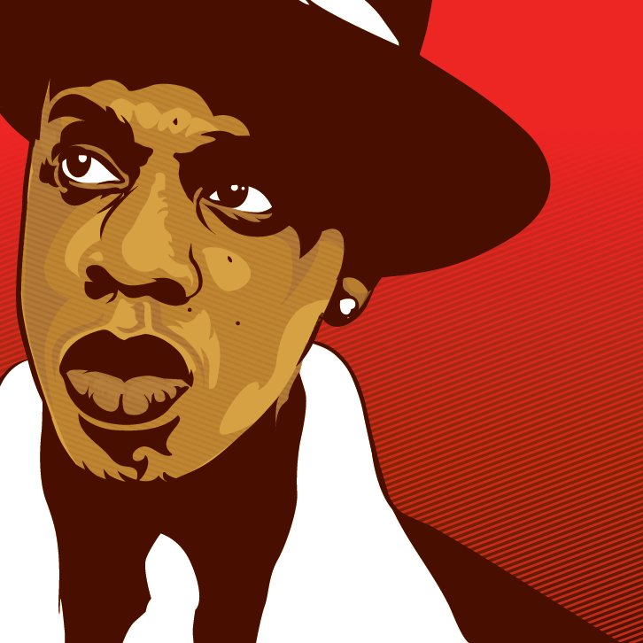
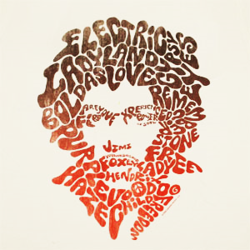
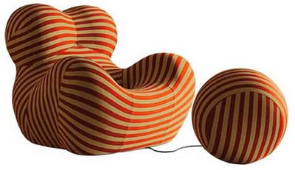
Huge
Graphics
Notes:
……and huge graphics on widely stretched spaces.

Slide 46
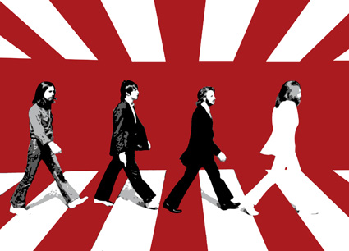
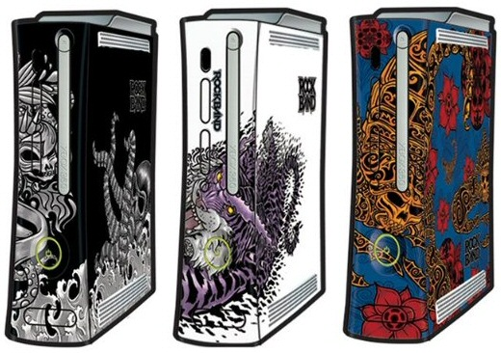
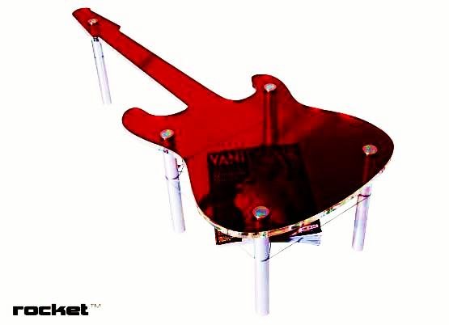
Rock ‘n Roll
Room
Notes:
In addition, since one of our main attractions is going to be the X-box rock bands installed in some of our rooms,
we are going to select a couple of theme rooms that will have more rock music influence in their designs.

Slide 47
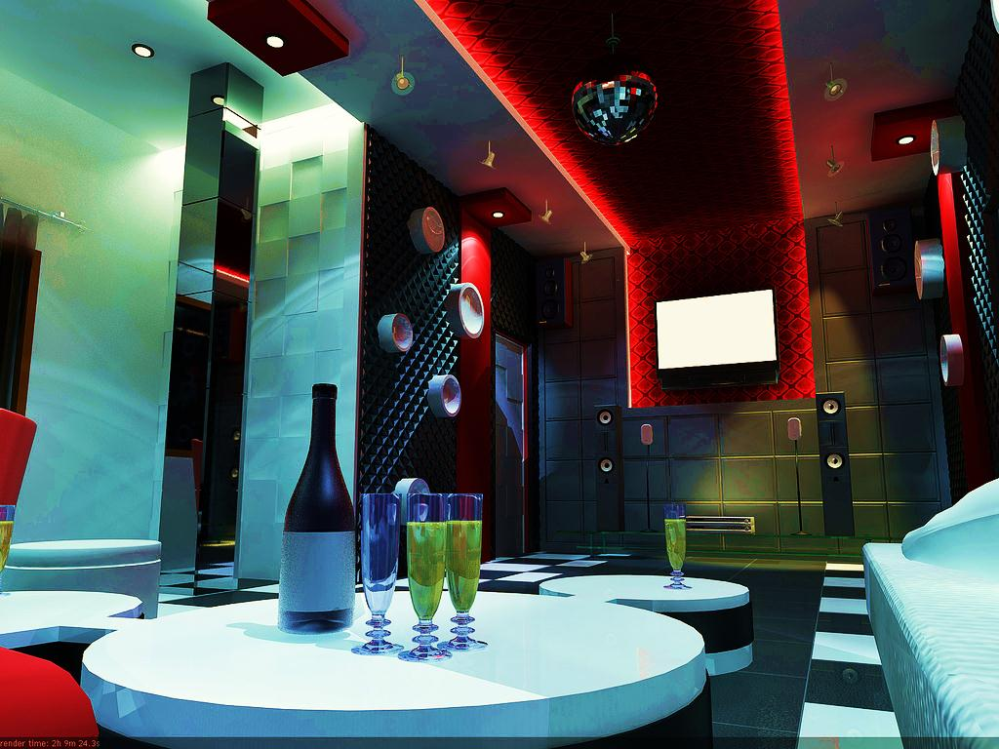
Notes:
Customers are going to walk in to Armada and find themselves in a casual and relaxing place where they can have some drinks with their buddies, sit back, relax and immerse themselves in fun and music.
It’s much like a bar lounge but with private spaces, karaoke machines and rock bands.

Slide 48
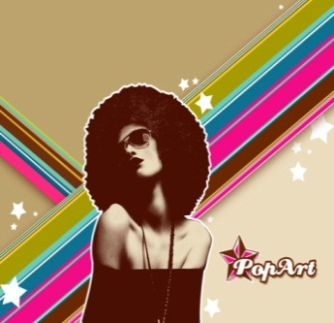
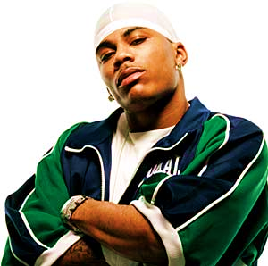
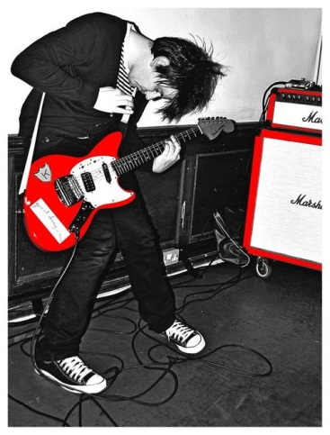
WOW
Armada
Notes:
Finally, one of the key aspects of our karaoke box is that it is a clash of cultures.
Our designs aim to integrate(click) these different styles and bring out the common theme,
which is the young modern individual’s self expression through music.
It’s definitely going to be a challenge.
But we have a concrete design plan of how we are going to do it, and we are confident in providing that wow factor that’s gonna bring a real storm to Seattle.
Now I will pass it on to Chris to talk about our promotion strategies.

Slide 49
Operations
Positioning
Financing
Promotion
Closing

Slide 50
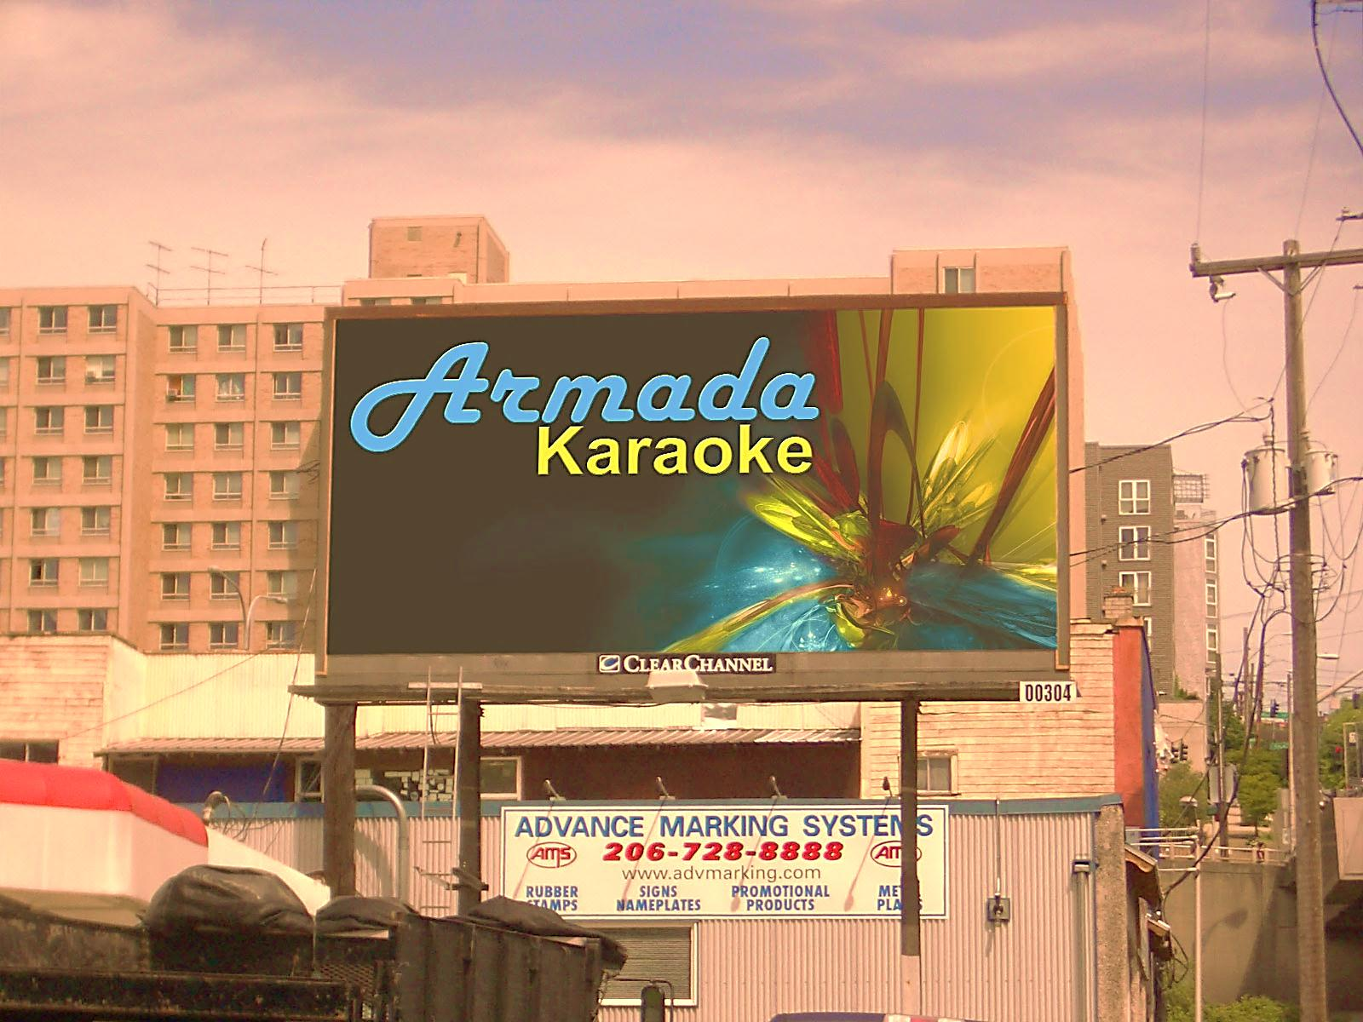
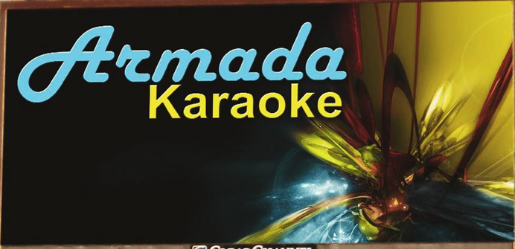
Promotional Strategy

Slide 51
The Competition

Slide 52
Integrated Promotional
Plan

Slide 53
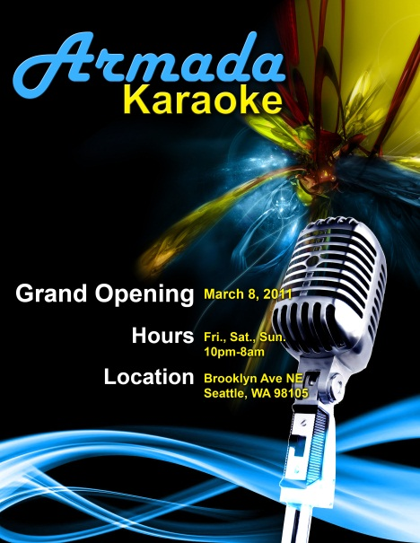
Flyers

Slide 54
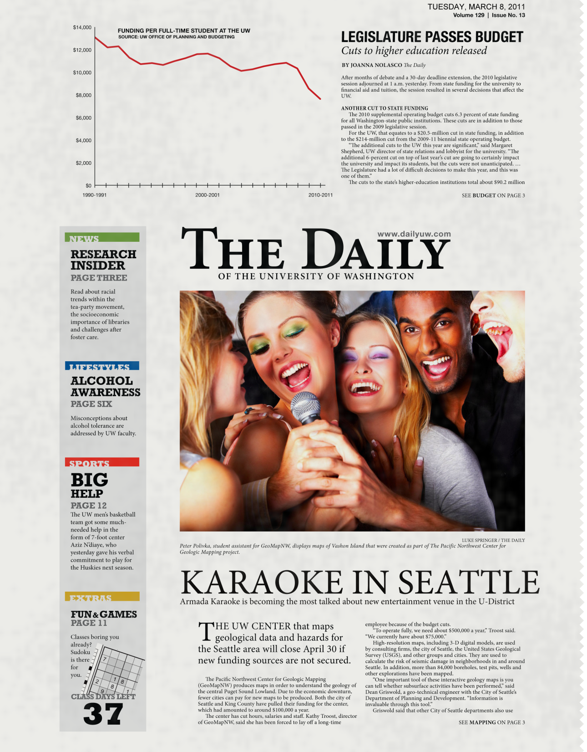
Newspaper

Slide 56
Architecture

Slide 57
Architecture

Slide 58
Word of Mouth

Slide 59
Operations
Positioning
Financing
Promotion
Closing

Slide 60
Numbers
Numbers
Notes:
Ladies and gentlemen, my name is Matthew li, the CFO of Armada
As a professional businessman, I fully understand that numbers are important.
Of course, numbers initiate; numbers motivate; and numbers benefit.

Slide 61
truly mean
Notes:
So ladies and gentlemen, please let me explain to you, what the importance of numbers truly mean in our case.

Slide 62
Annual Cost:
328,000
Notes:
The total cost of the first year will be 328 thousand dollars. And since the most of it are fixed costs, this number is not going to change significantly over years.

Slide 63
Revenue
Year 1 | Year 2 | Year 3 | Year 4 | Year 5
460,000 | 469,200 | 478,584 | 507,150 | 507,150
Notes:
Ladies and gentlemen, with our heavy advertising and unique features of our services, we will be able to start with revenue of 460 thousand dollars in the first year,
However, due to the size of our business and its limited capacity, our revenue will not experience a long period of growth.
Rather, it will grow at 2% in the first four years, and quickly reach its max potential in the fifth year

Slide 64
Net Income
Year 1 | Year 2 | Year 3 | Year 4 | Year 5
132,000 | 141,200 | 150,584 | 179,150 | 179,150
Net Income
Notes:
Our revenue will still be able to cover the cost starting the first year,
meaning, ladies and gentlemen, we will be profitable, starting the first year.

Slide 65
$521,230
Notes:
We might not have big-number earnings, because after all, this is a relatively small business and we are only asking for 521,230 thousand dollars.

Slide 66
ROE
Year 1 | Year 2 | Year 3 | Year 4 | Year 5
25% | 27% | 28% | 34% | 34%
Notes:
But considering the amount of money invested, we give back a pretty high return to our investors.
With our initial equity, we generate additional 25% profit out of it and this number reaches 34% in 4 years.

Slide 67
NPV
3-year $399,055.57
5-year $712,764.39
Notes:
The net present value of our earnings of the first three years is about 400 thousand dollars and 712 thousand for the 5-year period.

Slide 68
ROI (in present value)
3-years…………..77%
5-years ………………137%
Notes:
If this doesn't make any sense to you ladies and gentlemen, it means if you put in 100 dollars today and decide to invest for three years, you get additional 77 dollars return today right away, and if you extend your commitment to 5 years, you get additional 137 dollars today right away.
Ladies and gentlemen, these are great numbers. But please don't let the numbers just be numbers. Let the numbers be the opportunity of great investment, let the numbers be your profitability, and let the numbers be your richer and brighter future.
Thank you ladies and gentlemen, I am going to pass it on to Vincent the CEO.

Slide 69
Operations
Positioning
Financing
Promotion
Closing

Slide 70
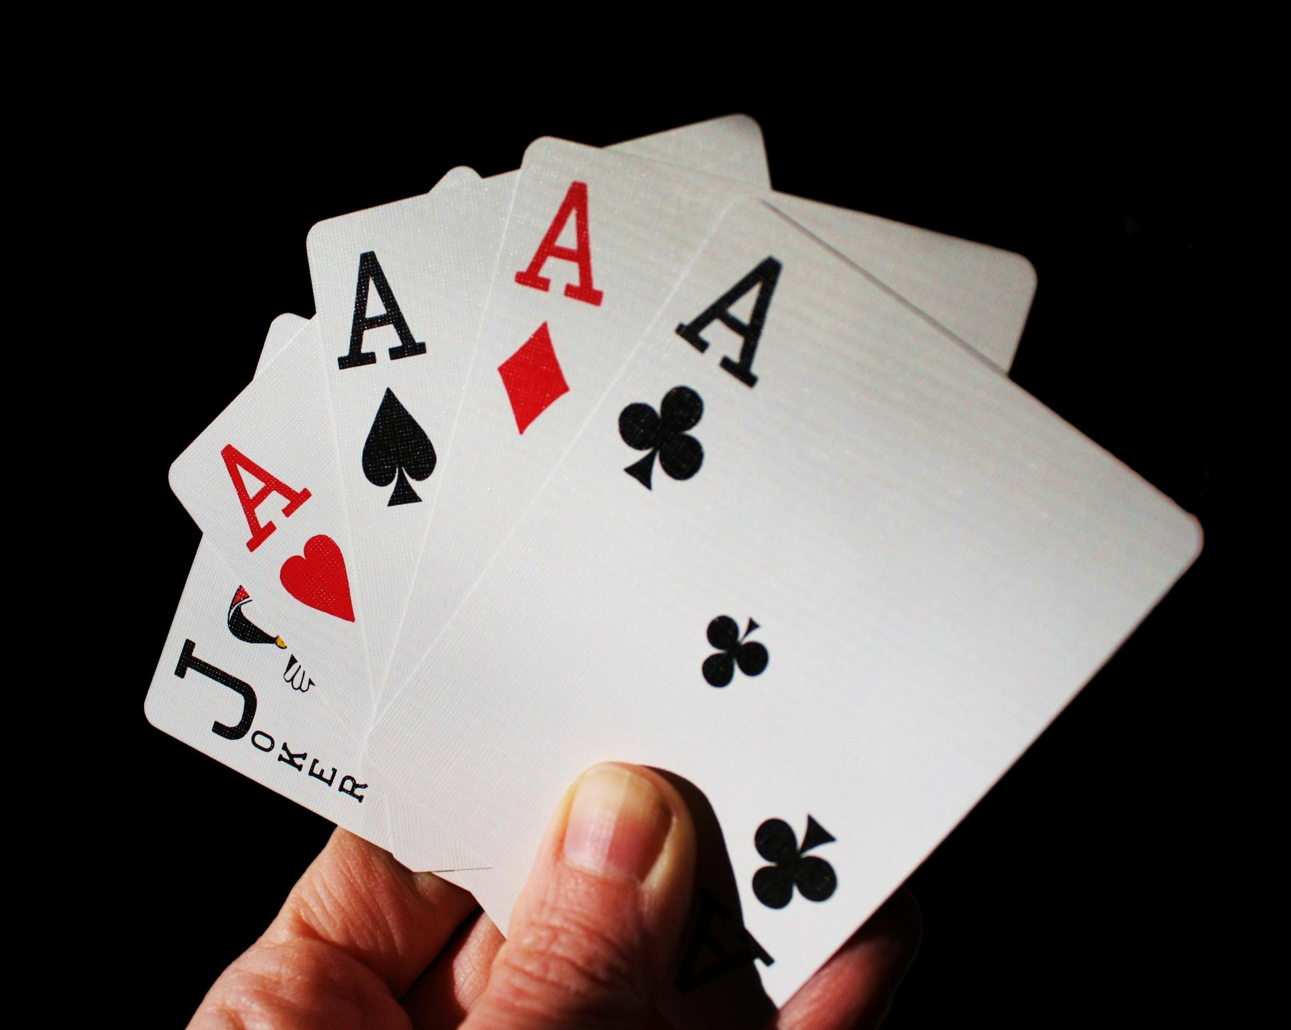

Slide 71
Investment

Slide 72
RETURNS
RETURNS
RETURNS
RETURNS
RETURNS
RETURNS
RETURNS
RETURNS
RETURNS
RETURNS
RETURNS
RETURNS
RETURNS
RETURNS
RETURNS
RETURNS
RETURNS
RETURNS
RETURNS
RETURNS
RETURNS
RETURNS
RETURNS
RETURNS
RETURNS
RETURNS
RETURNS
RETURNS
RETURNS
RETURNS
RETURNS
RETURNS
RETURNS
RETURNS
RETURNS
RETURNS
RETURNS
RETURNS
RETURNS
RETURNS
RETURNS
RETURNS
RETURNS
RETURNS
RETURNS
RETURNS
RETURNS

Slide 77
Q&A

Slide 78
Equipment | 85,730
Interior Design | 100,000
Licensing | 7,500
Starting Capital: | 193,230
Yearly Costs:
Rent | 96,000
Wage & Salary | 180,000
Utility | 12,000
Food & Drinks | 40,000
Total Yearly Costs: | 328,000
TOTAL COSTS: | 521,230

